Slide 1
Agile Integration Architecture Part 3: The benefits of containerization
Kim Clark
Integration Architect
Integration Portfolio
Webinar recording: https://ibm.ent.box.com/s/cnm1yipiptiwxa4v62qq7o4eb7wh7ebz/file/343245598882

Slide 2
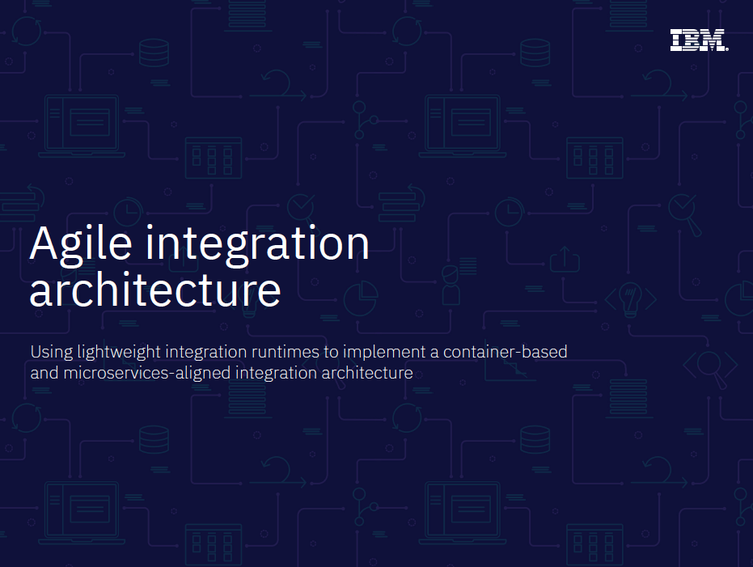
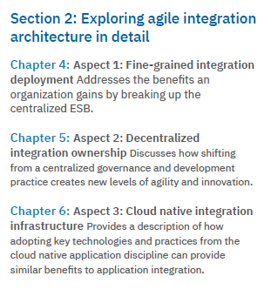
eBooklet: https://www.ibm.com/cloud/agile-integration-architecture
Notes:
Cloud comp continues to evolve from cost savings utility to critical accelerator and business differentiator
Almost no company has the ability to be 100% cloud
Today’s IT more fragmented and complex – average 6 clouds
Spans public, private
Apps migrating back and forth and operating across multi-cloud
Need an integration platform that fully supports multi-cloud

Slide 3
Agile Integration
…to enable business agility
Improve build independence and production velocity
(deployment agility)
Architecture & design
Fine grained deployment
People & Process
Decentralized Ownership
Accelerate agility and innovation
(development agility)
Infrastructure & Technology
Dynamic scalability and inherent resilience
(operational agility)
Cloud native
infrastructure
Notes:
Wi A container-based, decentralized and microservices-aligned architecture for modern integration solutions.

Slide 4
Typical benefits sought from a move to microservices
Architecture & design
Fine grained deployment
Monolithic
Application
Microservice Application
µService
µService
µService
µService
µService
µService
µService
µService
µService
Agility
Faster iteration cycles, bounded contexts, autonomous teams
Scalability
Elastic scalability, workload orchestration, cloud infrastructure
Resilience
Minimized dependencies, discrete failover, fail fast, start fast

Slide 5
Application Integration perspective
Traditional application integration
(centrally provisioned and administered silo)
Isolated integration deployment,
application ownership,
cloud-ready implementation

Slide 6



Organizational decentralization from an integration perspective
People & Process
Decentralized Ownership
Integration

Slide 7
Improve build independence and production velocity
Architecture & design
Fine grained deployment
Agile Integration drives the change
People & Process
Decentralized Ownership
Accelerate agility and innovation
Infrastructure & Technology
Dynamic scalability and inherent resilience
Cloud native
infrastructure
Notes:
Wi A container-based, decentralized and microservices-aligned architecture for modern integration solutions.

Slide 8

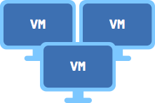

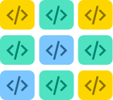
Bare Metal
Reducing infrastructure cost
More fine grained cost models
Less operations cost
More “disposable” less “nurtured”
Virtual machines
Cost of entry of first function
Containers
Functions
Increasing abstraction from infrastructure
Notes:
Old style mainframe (powerful hardware is everything, developers are cheap in comparison) – (mainframes are very different today!)
Distributed (lowered the cost of shared servers)
Individual workstations became accessible (PC + “fat client” revolution)
Hardware became cheap. Throwing more hardware at problems as hardware becomes cheap
Virtualization abstracted us from hardware (IBM LPARs, then modern hypervisors for other operating systems)
Containerization abstracted us from the operating system, (create multiple isolated components on a single operating system)
Container orchestration (Manage many containers, using grouping, service level and dependency policies)
Serverless architecture (more specifically FaaS) abstracts us from the process/thread: provide platforms that auto-scale and completely hide the underlying infrastructure. Cost model becomes directly related to compute, down to the lowest granularity, and through multi-tennancy with high efficiency. Costs have plummeted. Human resources have now become the main cost. Especially in small teams, e.g. in a 4 person if you can free up just one person from infrastructure duties, that could provide many tens of percent increase in productivity.

Slide 9
Difference between virtual machines and containers
Virtual Machines
Containers
Infrastructure
Infrastructure
Hypervisor
Host OS
VM
VM
Docker
Guest OS
Guest OS
Container
Container
Container
Bins/Libs
Bins/Libs
App
App
App
Bins/Libs
Bins/Libs
Bins/Libs
App
App
App
Derived from https://www.docker.com/what-container

Slide 10
Benefits of a container based strategy
Infrastructure & Technology
Cloud native
infrastructure
Build Agility
Component Portability
Team Productivity
Fine-grained Resilience
Operational Consistency
Scalability and Optimization
Containerization is more than just a re-platforming exercise. “lift and shift” will not bring the above benefits.
Requires: Fine-grained deployment, organizational decentralization, pipeline automation, disposable components…
Notes:
Containers are much more than just the next step in the evolution of virtual machines.
A container strategy has many benefits:
Team Agility - Containers allow multiple teams to build their own solutions independent of others. This allows the team to adapt to change more rapidly, than being dependent on wider teams, allowing them reach a greater team velocity. As containers are specific to a team and a particular project, they are smaller in nature, which allows for fast deployment. The isolation also provides the ability for reliable deployments. Once a container is created, environment variables are used to customize for particular target environments – this leads to a reliable deployment model, were the capacity requirements are controlled by the container orchestration technology – and hence greater agility.
Fine Grained Resilience - to embrace cattle instead of a pets approach. If the container stops working, then kill it off, and start a new one. This reduces the cost, effort of maintenance and potentially the overall resilience of the solution.
Infrastructure Optimization - Containers also enable better density within an infrastructure. Containers have less memory overhead per instance because each application is loaded into a host OS that’s shared across all containers. Operating systems and kernels don’t need to be loaded per container. Far more containers can be run per bare-metal machine, when compare with virtualization technology such as VMWare.
Scalability & Continuous Availability - we will look at the applicability of this for MQ later, but logically containers can be scaled and a load balancer across the available instances. This provides scalability and also continuous availability, from the point of view of an IBM MQ Queue being able to handle new MQ PUT requests, even in failure situations.
Operational Consistency - all parts of a solution are deployed and managed in the same way – as containers, regardless of the underlying product. This is utopia, however significant gains from a common deployment, management, operational and monitoring approach are provided.
Component Portability - Any platform with a container engine can run containers. This means the barrier to moving from one cloud provider to another is lowered (e.g. multi-cloud).
Important to make clear the difference between benefits and the charactertics of a containerization strategy:
Therefore I have removed:
Isolation – this is a charactertics of a containerized strategy that allows greater agility and simplified management (which is really consistency).
Isolation – Each container is self-contained, normally within an application boundary, this reduced the dependency chain.
Decomposition – Monolithic which are hard to maintain are removed, when new version of the solution and underlying technology is required, the impact is limited to the individual application, instead of across all applications. Again this is really agility.
Immutable: Container images are versions, Containers cannot (should not) be patched. Again this provides the disposability and agility.

Slide 11
Benefits of a container based strategy
Infrastructure & Technology
Cloud native
infrastructure
Build Agility
Component Portability
Team Productivity
Fine-grained Resilience
Operational Consistency
Scalability and Optimization
Containerization is more than just a re-platforming exercise. “lift and shift” will not bring the above benefits.
Requires: Fine-grained deployment, organizational decentralization, pipeline automation, disposable components…
Notes:
Containers are much more than just the next step in the evolution of virtual machines.
A container strategy has many benefits:
Team Agility - Containers allow multiple teams to build their own solutions independent of others. This allows the team to adapt to change more rapidly, than being dependent on wider teams, allowing them reach a greater team velocity. As containers are specific to a team and a particular project, they are smaller in nature, which allows for fast deployment. The isolation also provides the ability for reliable deployments. Once a container is created, environment variables are used to customize for particular target environments – this leads to a reliable deployment model, were the capacity requirements are controlled by the container orchestration technology – and hence greater agility.
Fine Grained Resilience - to embrace cattle instead of a pets approach. If the container stops working, then kill it off, and start a new one. This reduces the cost, effort of maintenance and potentially the overall resilience of the solution.
Infrastructure Optimization - Containers also enable better density within an infrastructure. Containers have less memory overhead per instance because each application is loaded into a host OS that’s shared across all containers. Operating systems and kernels don’t need to be loaded per container. Far more containers can be run per bare-metal machine, when compare with virtualization technology such as VMWare.
Scalability & Continuous Availability - we will look at the applicability of this for MQ later, but logically containers can be scaled and a load balancer across the available instances. This provides scalability and also continuous availability, from the point of view of an IBM MQ Queue being able to handle new MQ PUT requests, even in failure situations.
Operational Consistency - all parts of a solution are deployed and managed in the same way – as containers, regardless of the underlying product. This is utopia, however significant gains from a common deployment, management, operational and monitoring approach are provided.
Component Portability - Any platform with a container engine can run containers. This means the barrier to moving from one cloud provider to another is lowered (e.g. multi-cloud).
Important to make clear the difference between benefits and the charactertics of a containerization strategy:
Therefore I have removed:
Isolation – this is a charactertics of a containerized strategy that allows greater agility and simplified management (which is really consistency).
Isolation – Each container is self-contained, normally within an application boundary, this reduced the dependency chain.
Decomposition – Monolithic which are hard to maintain are removed, when new version of the solution and underlying technology is required, the impact is limited to the individual application, instead of across all applications. Again this is really agility.
Immutable: Container images are versions, Containers cannot (should not) be patched. Again this provides the disposability and agility.

Slide 12
What skills and capabilities are required to get something into production?
Author artefacts
(design, implement, maintain)
Arrange delivery
(source control, install, compile, build, verify, test)
Allocate resources
(cpu, memory, storage, connections)
Configure routing
(load balancing, failover, traffic control, re-try, timeout, load shedding/shaping, request tracing)
Enforce security
(authentication, access control, certificates, encryption, port provisioning)
Perform deployment
(scaling, distributed deploy, rolling update, A/B testing, blue/green deployment, canary releases)
Manage operations
(health checks, monitoring, tracing, log aggregation, quotas)
Artefacts
Resources
Deployment
Operations
Delivery
Routing
Security

Slide 13
Traditional infrastructure
(nurtured)
Cloud native infrastructure
(disposable)
Artefacts
Resources
Deployment
Operations
Delivery
Routing
Security
Artefacts
Resources
Deployment
Operations
Delivery
Routing
Security
Runtime specific
Provided by platform

Slide 14
What capabilities does the cloud platform provide to all runtimes
Delivery
e.g. Docker build, Jenkins, Git
Resource allocation
e.g. Kubernetes, Mesos
Deployment
e.g. Kubernetes, Helm
Routing
e.g. Istio, Linkerd
Security
e.g. Kubernetes/Istio/SPIFFE
Operations
e.g. ELK stack
Runtime
Artefacts
Resources
Deployment
Operations
Delivery
Routing
Security
Runtime specific
Provided by platform

Slide 15
Challenges of traditional deployment topologies
System
Administration
Characteristics
HA pairs
Scaling manual and vertical
Defined nodes
Explicit install and configure
Explicit cold/warm HA & DR
Peak CPU licensing
Dedicated OS instances/HW
Deploy to running shared servers
Replication across DCs
Administer live shared servers
Code is only joined with the servers at deployment.
Load bal.
Load bal.
Load bal.
Load bal.
Monitoring
HA1
HA2
DR1
DR2
P1
P2
D1
D2
Deployment Manager
a
b
a
b
c
c
replication
P2
P1
D2
D1
Release repository
Compile/
Build
Process
HA
Manager
HA
Manager
Code repository
Product specific component
Authoring
Product specific artefact

Slide 16
Simplicity and scaling benefits of cloud native platforms
Template Image repository
Cloud platform
Load bal.
Load bal.
Load bal.
Elastically scaled containers
Pooled shared underlying resources, but decoupled containers
Implicit HA/DR
Deploy by image combining artefacts and infrastructure
Administer image then redeploy, not hot fixing.
Image
Build
Orchestration Framework
a
b
c
a
a
b
c
a
a
c
Code repository
a
a
Release
Image repository
a
Authoring
a
Log aggregator
Monitoring
Product specific component
a
Product specific artefact

Slide 17
What Moves Per Release
Key
VM
Worker Node
Created new for each new code version
Runtime
Code
Container
Remains same for each new code version
Runtime
Fixed
Configuration
Code
Fixed
Configuration
Environment
Configuration
Environment Configuration
Traditional
Cloud-native

Slide 18
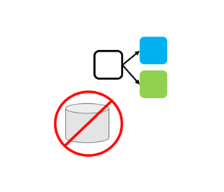
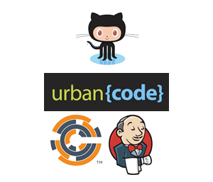
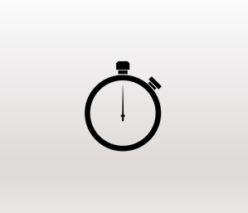
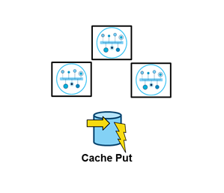
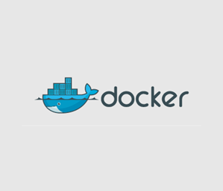

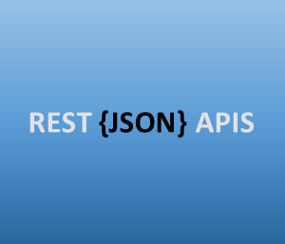
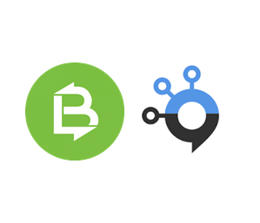
IBM App Connect Enterprise (formerly known as IBM Integration Bus)
DEVOPS TOOLING SUPPORT
STATELESS ENGINE
DISTRIBUTED DEPLOY READY
VIRTUAL-IZATION SUPPORT
FAST LIGHT DEPLOYMENT
CLOUD FIRST
JSON / REST SUPPORT
CONNEC-TIVITY

Slide 19
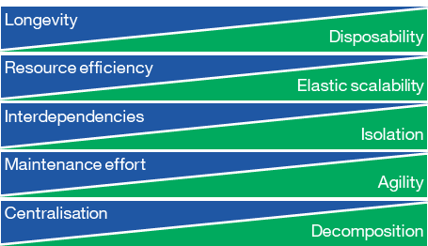
Traditional vs. Cloud Native

Slide 20
The move to agile integration architecture is a gradual process, not a big bang
Engagement
Applications
Microservice
applications
Traditional
Integration
Integration
iPaaS
Systems
of Record
SaaS Applications

Slide 21
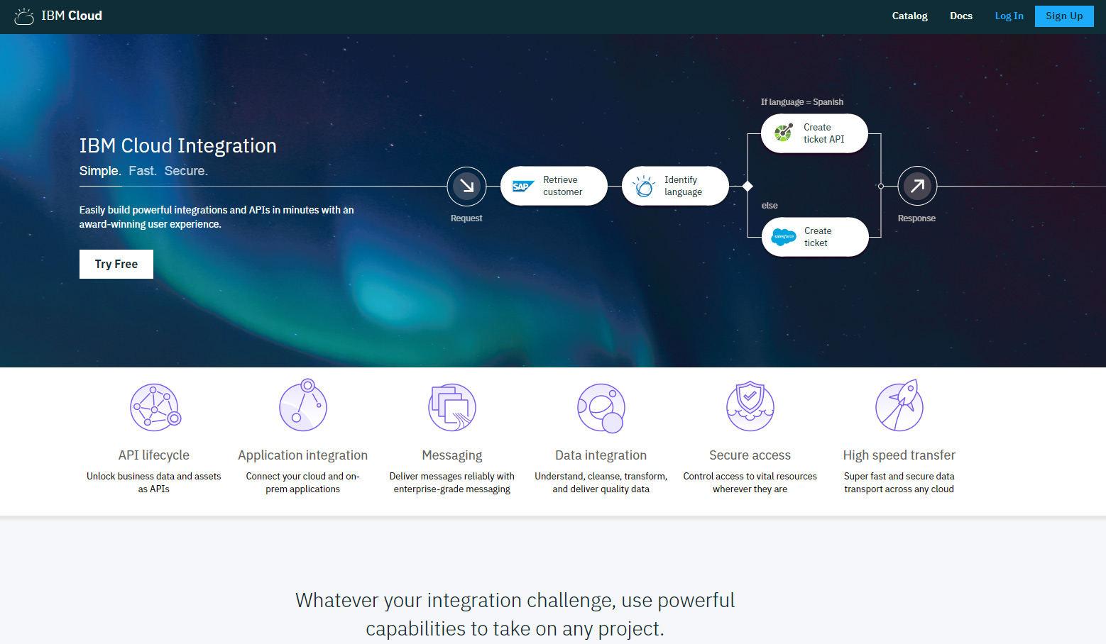
One Platform for Simple, Fast, and Secure Multi-cloud Integration
Notes:
IBM has been working very hard to empower clients to securely harness data and services wherever they reside
Excited to announce IBM Cloud Integration – only integration platform build on
Market tested and Market leading capabilities
With the ability to be deployed anywhere – on-prem on any cloud, public or private
And, with flexible consumption models from perpetual to subscription to hybrid to flex.
Most comprehensive set of integration capabilities including
Messaging, App Integration, API Integration, Data Integration, High Speed Data Transfer, and Secure Access.
Don’t let award winning UX belie the incredible enterprise power underneath
One platform for Simple, Fast, and Secure

Slide 22
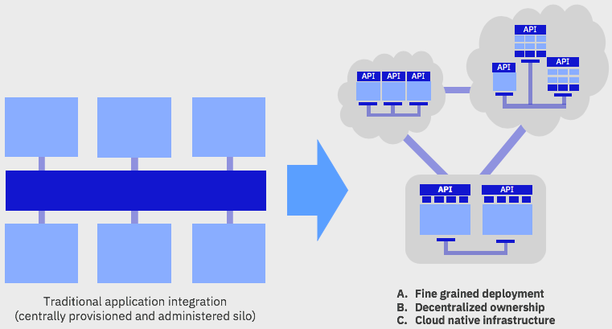
Agile Integration

Slide 23
Agile Integration

Slide 24

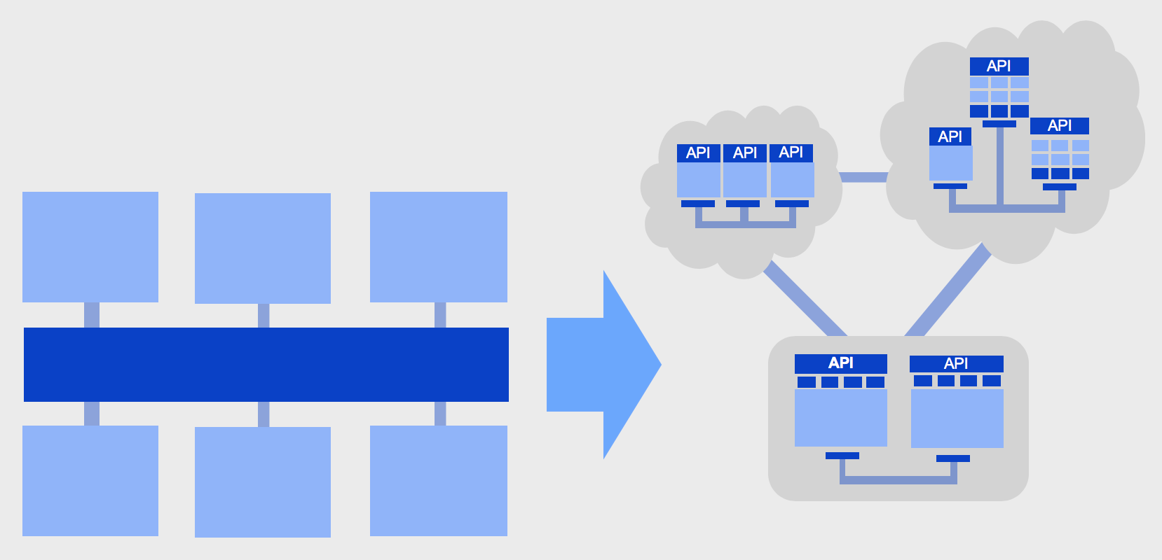
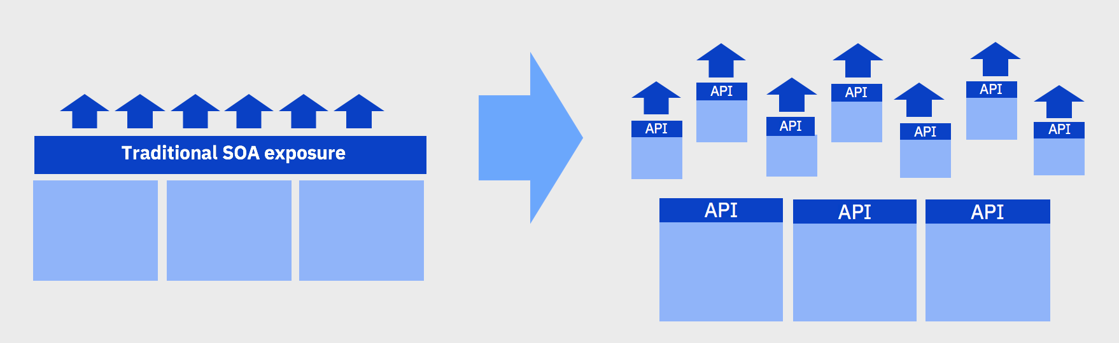
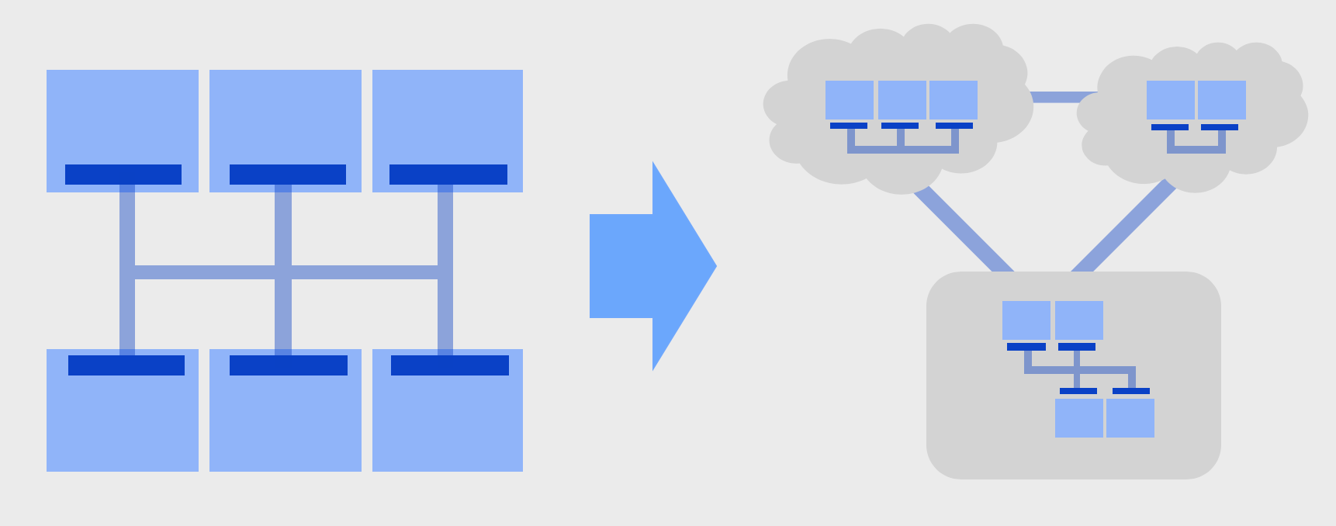
Perspectives on Agile Integration
Application Integration
perspective
API
perspective
Messaging
perspective
Agile Integration

Slide 25
The evolving hybrid integration reference architecture
https://ibm.biz/HybridIntRefArch
http://ibm.biz/HybridIntRefArchYouTube
The fate of the ESB
http://ibm.biz/FateOfTheESBPaper
Public material on agile integration
Agile Integration
http://ibm.biz/agile-integration
http://ibm.biz/agile-integration-webinar
http://ibm.biz/agile-integration-redbook
Useful links on agile integration architecture
http://ibm.biz/agile-integration-links
“Microservices, SOA, and APIs: Friends or enemies?”
https://ibm.biz/MicroservicesVsSoa
http://ibm.biz/MicroservicesVsSoaWebinar
Staying up to date:
https://developer.ibm.com/apiconnect/blog
https://developer.ibm.com/integration/blog
https://developer.ibm.com/messaging/blog

Slide 26
www.ibm.com/integration
Think 2018 / 8272 / March 2018 / © 2018 IBM Corporation
Notes:
Please join us at the Think Tanks directly after this session where you can
Meet Experts
Listen to Customer Panels
Learn more about Agile Lightweight Enterprise Integration
And See and Expanded Demonstration of IBM Cloud Integration at work
Thank you and Enjoy IBM Think 2018

